Slide 1
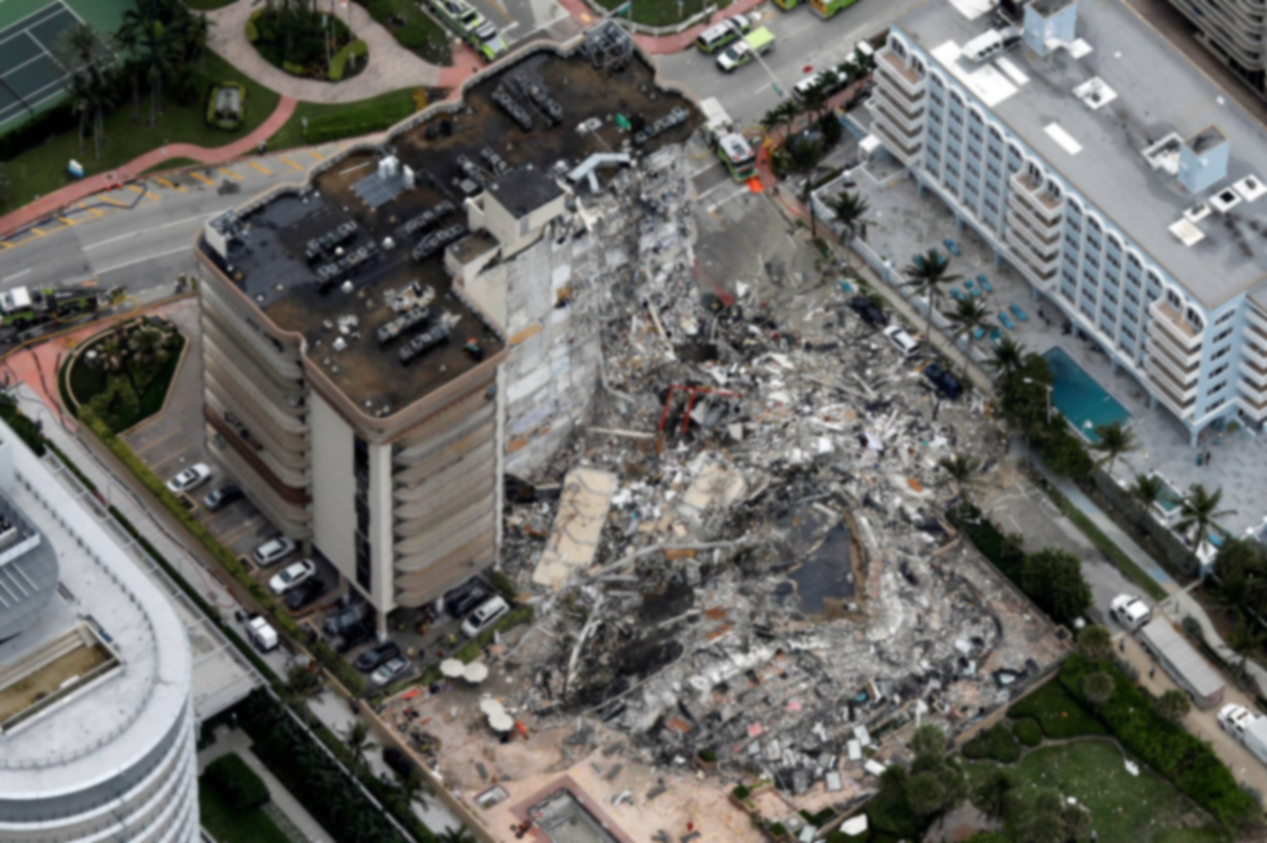
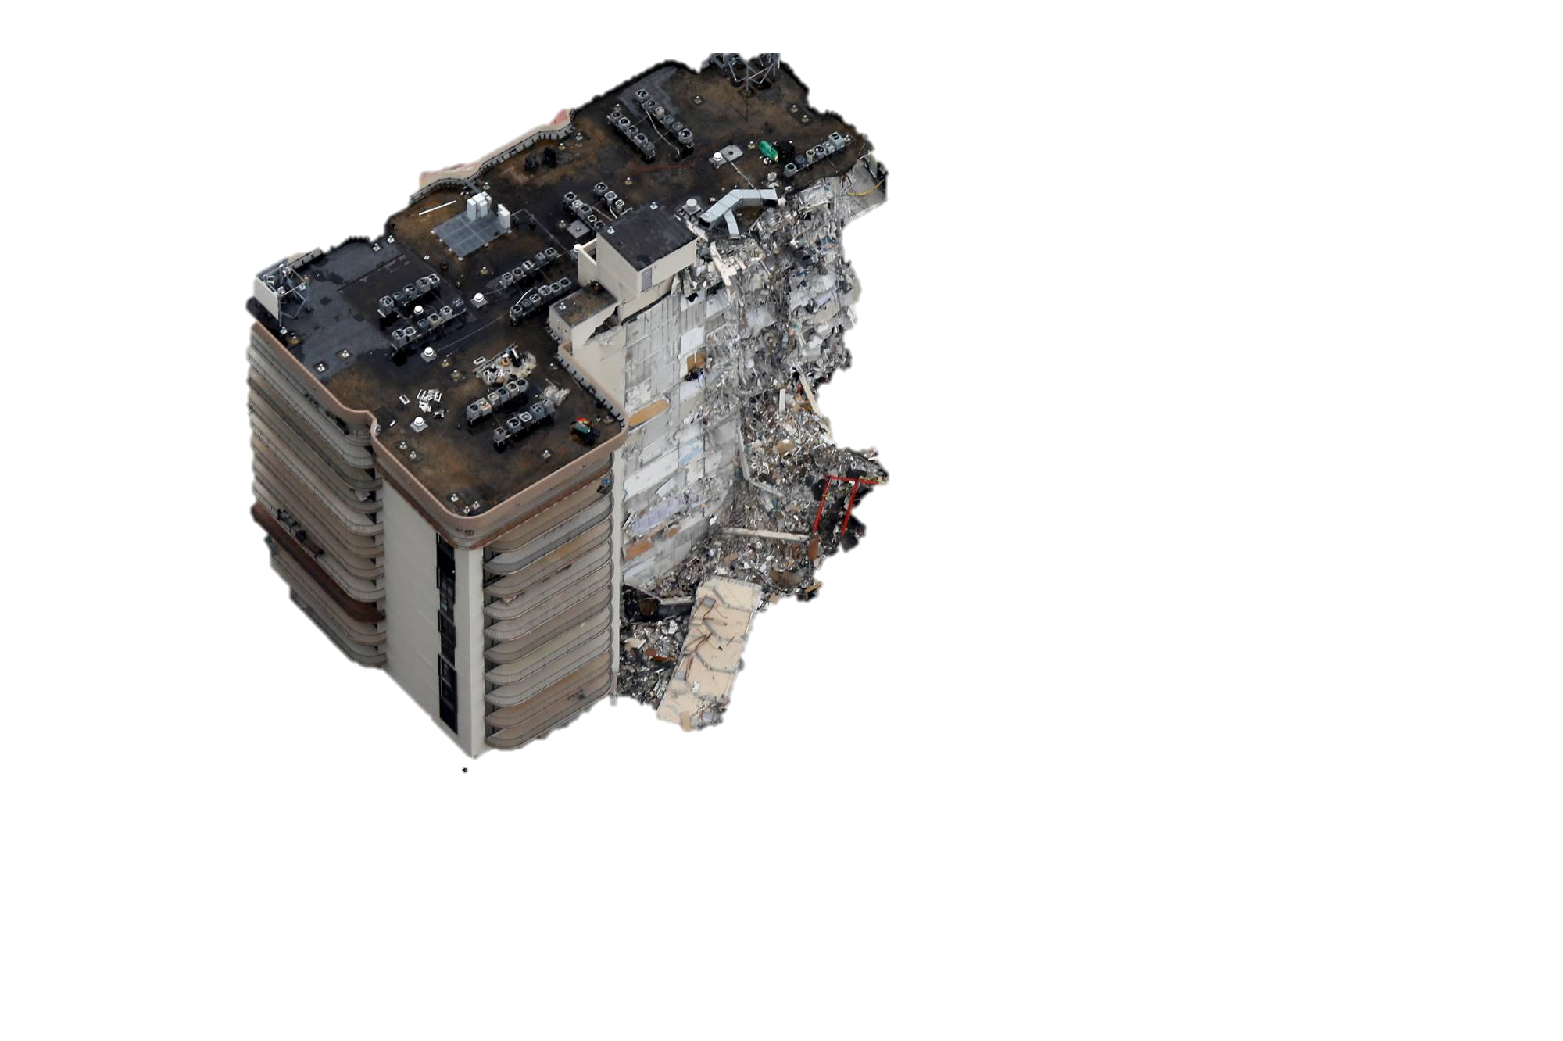
Miami Surfside
Condo Collapse

Slide 2
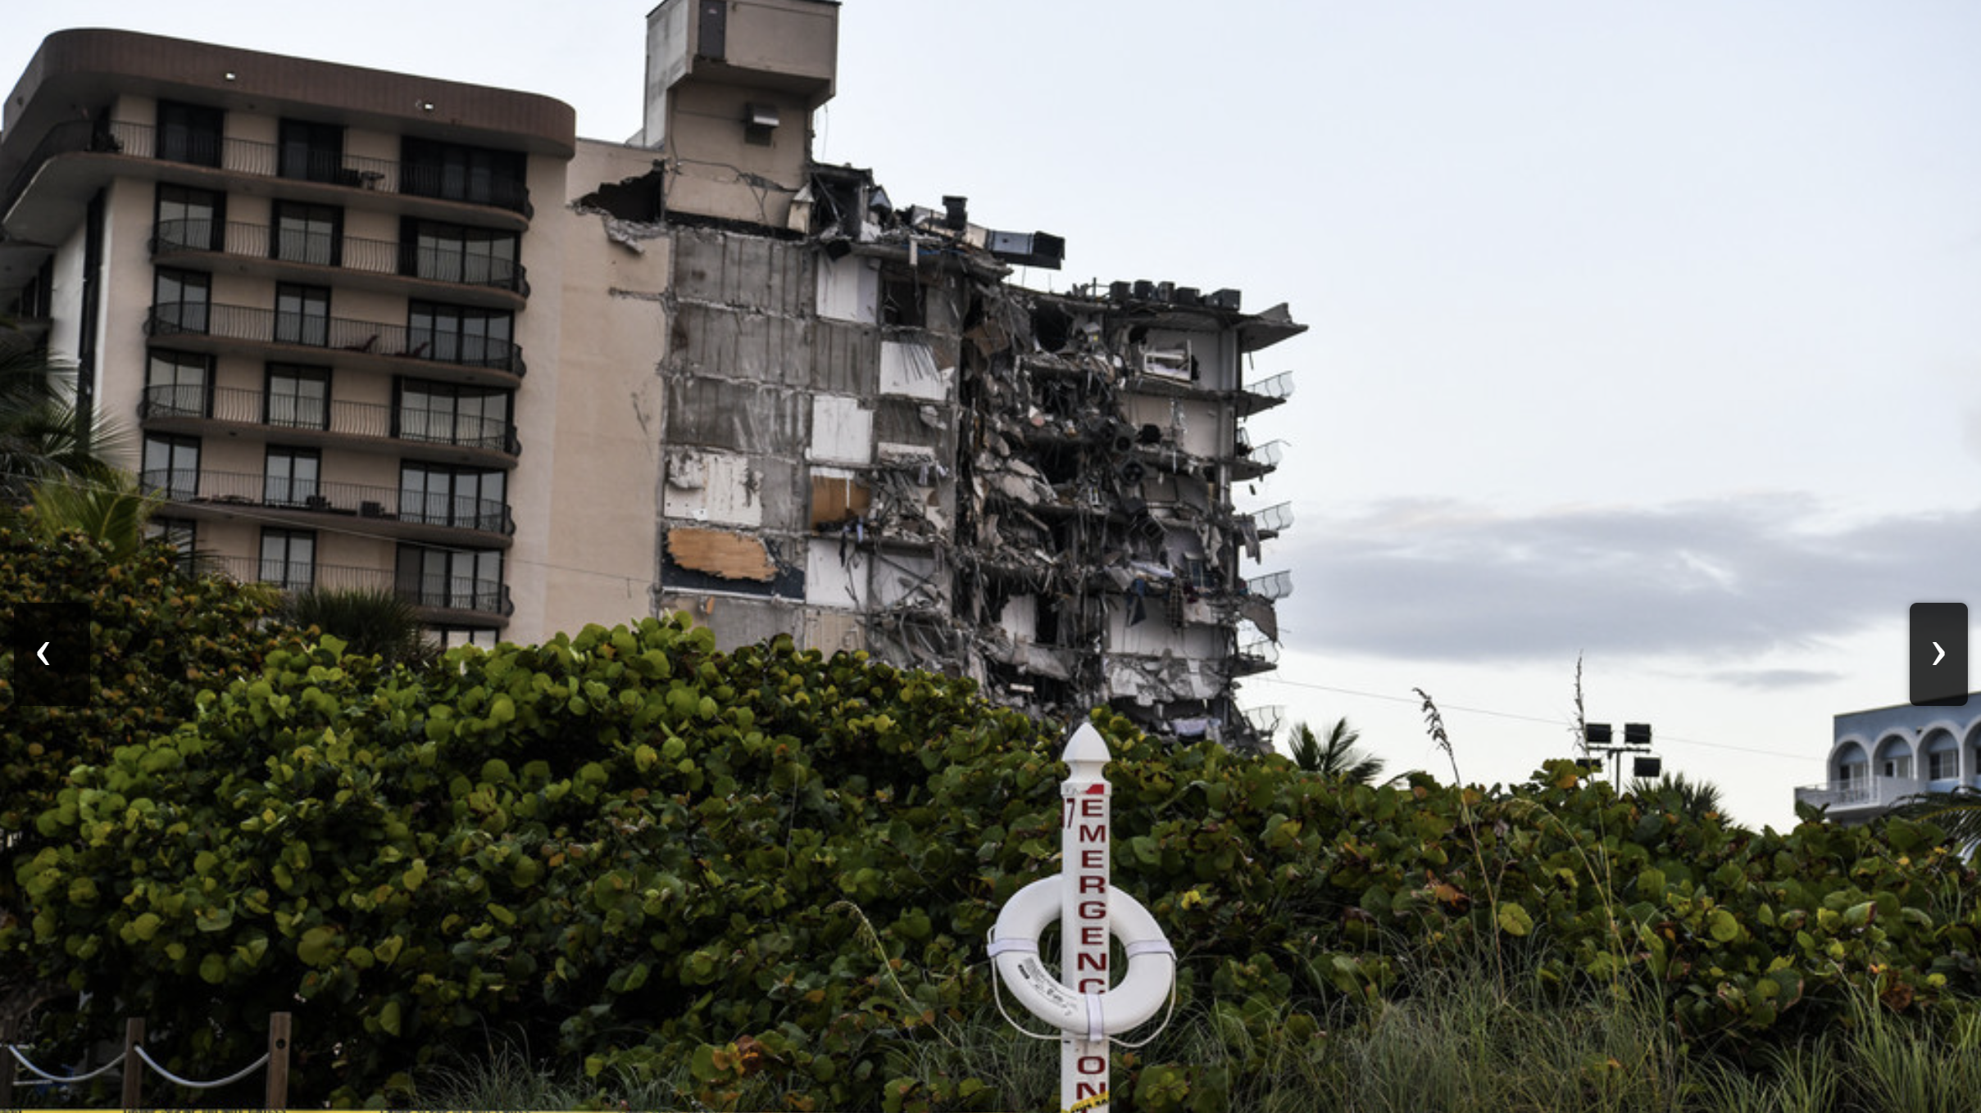
What was the Failure?
Water seeped onto concrete columns
The Columns failed to support the weight of the collapse

Slide 3

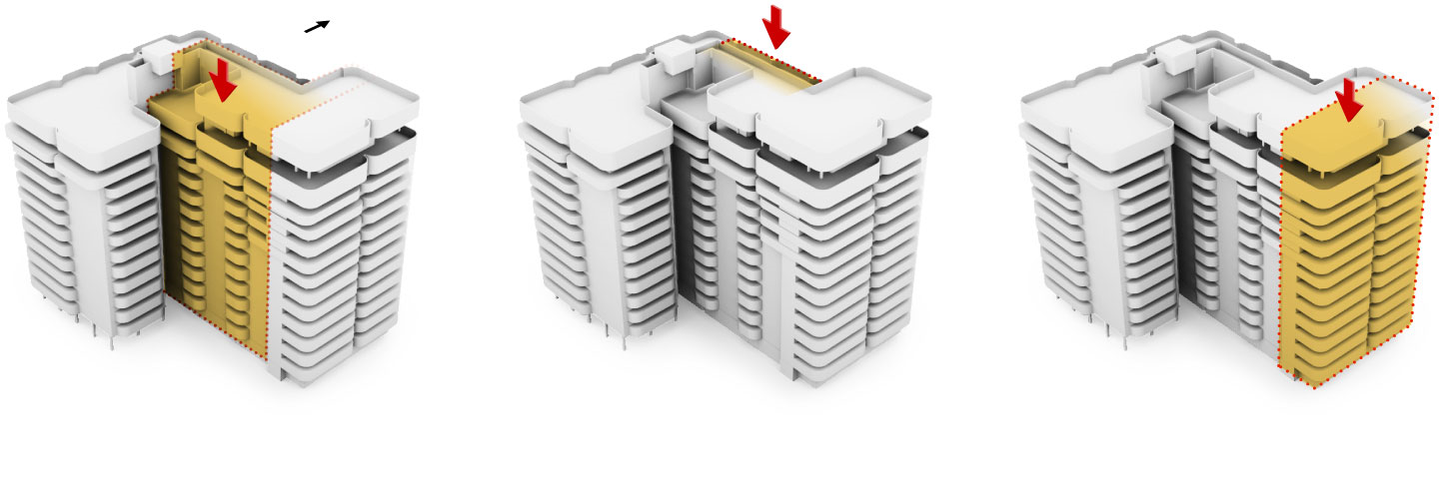

Slide 4
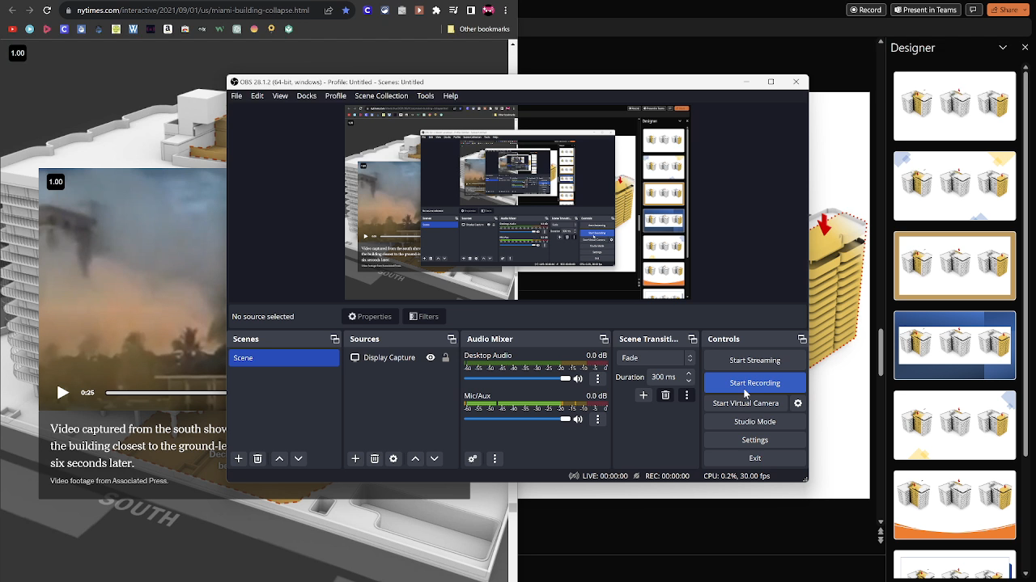

Slide 5
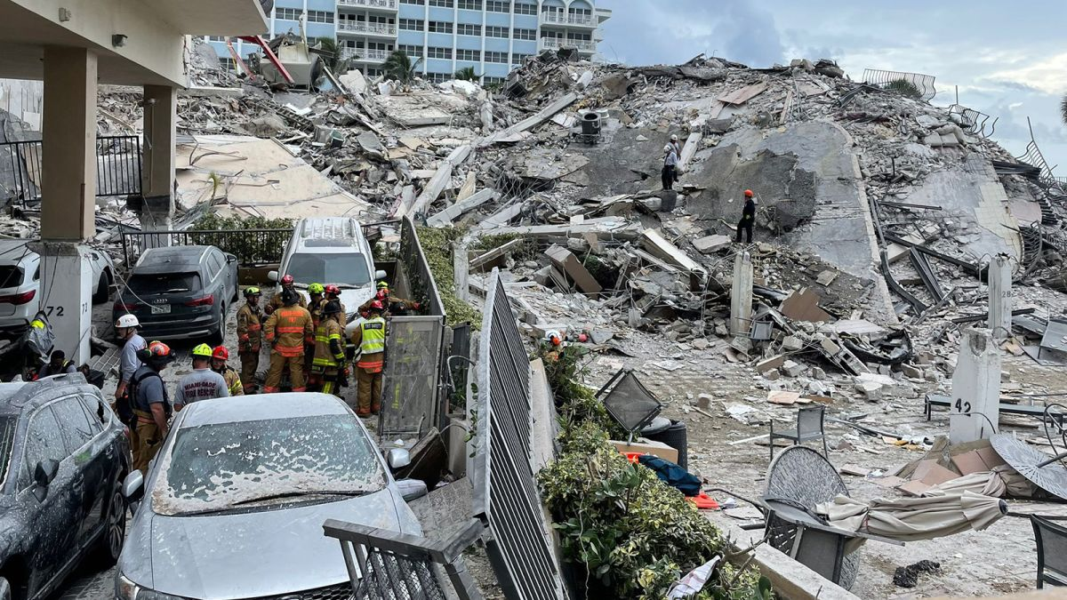
The Reason it Failed
Either overcrowding or too little steel support in columns
Failure of concrete pours
Vibrations from construction next door

Slide 6
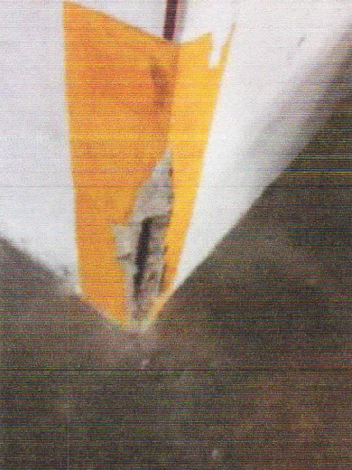
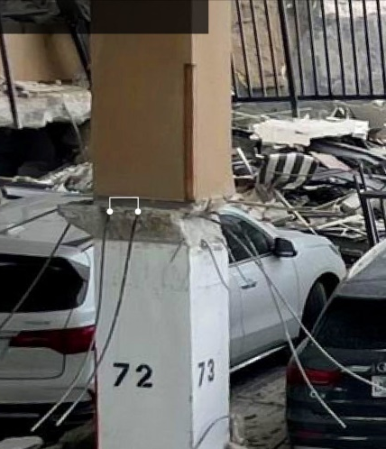
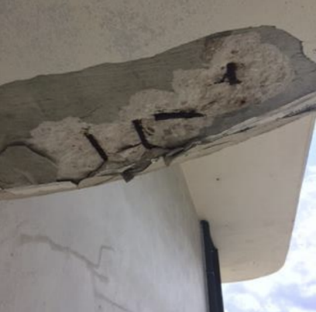

Slide 7
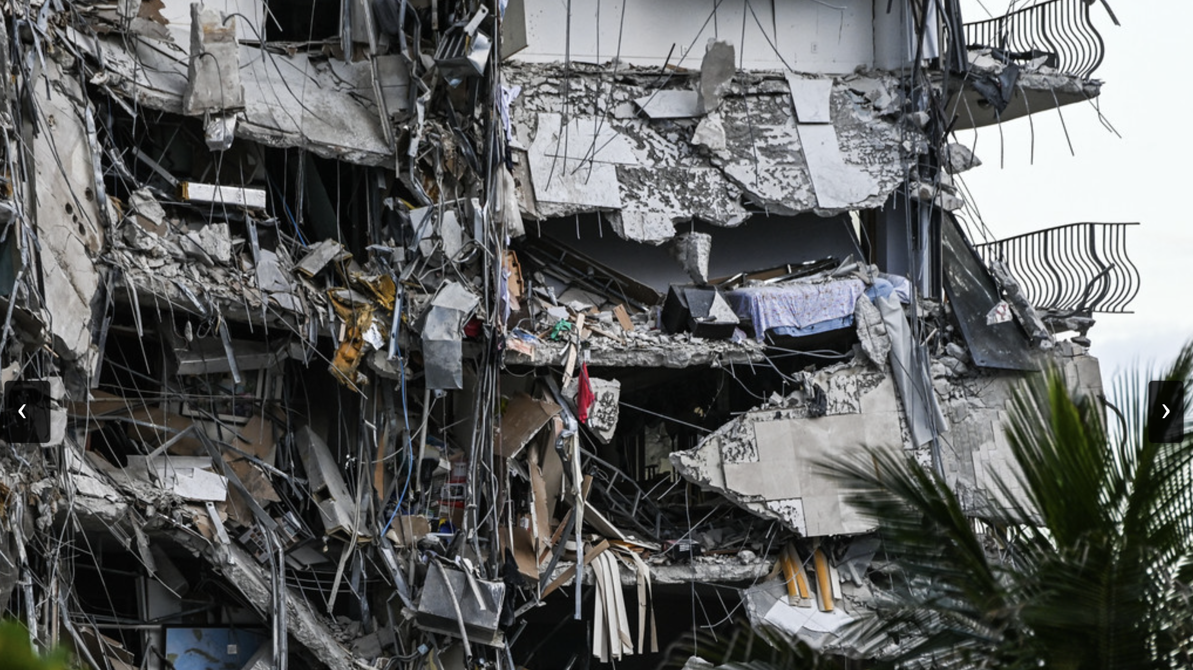
Who was at Fault and Why?
Lawsuit believes engineers and firm building next door created the damage
Construction workers who build the condo and failed to follow plans

Slide 8
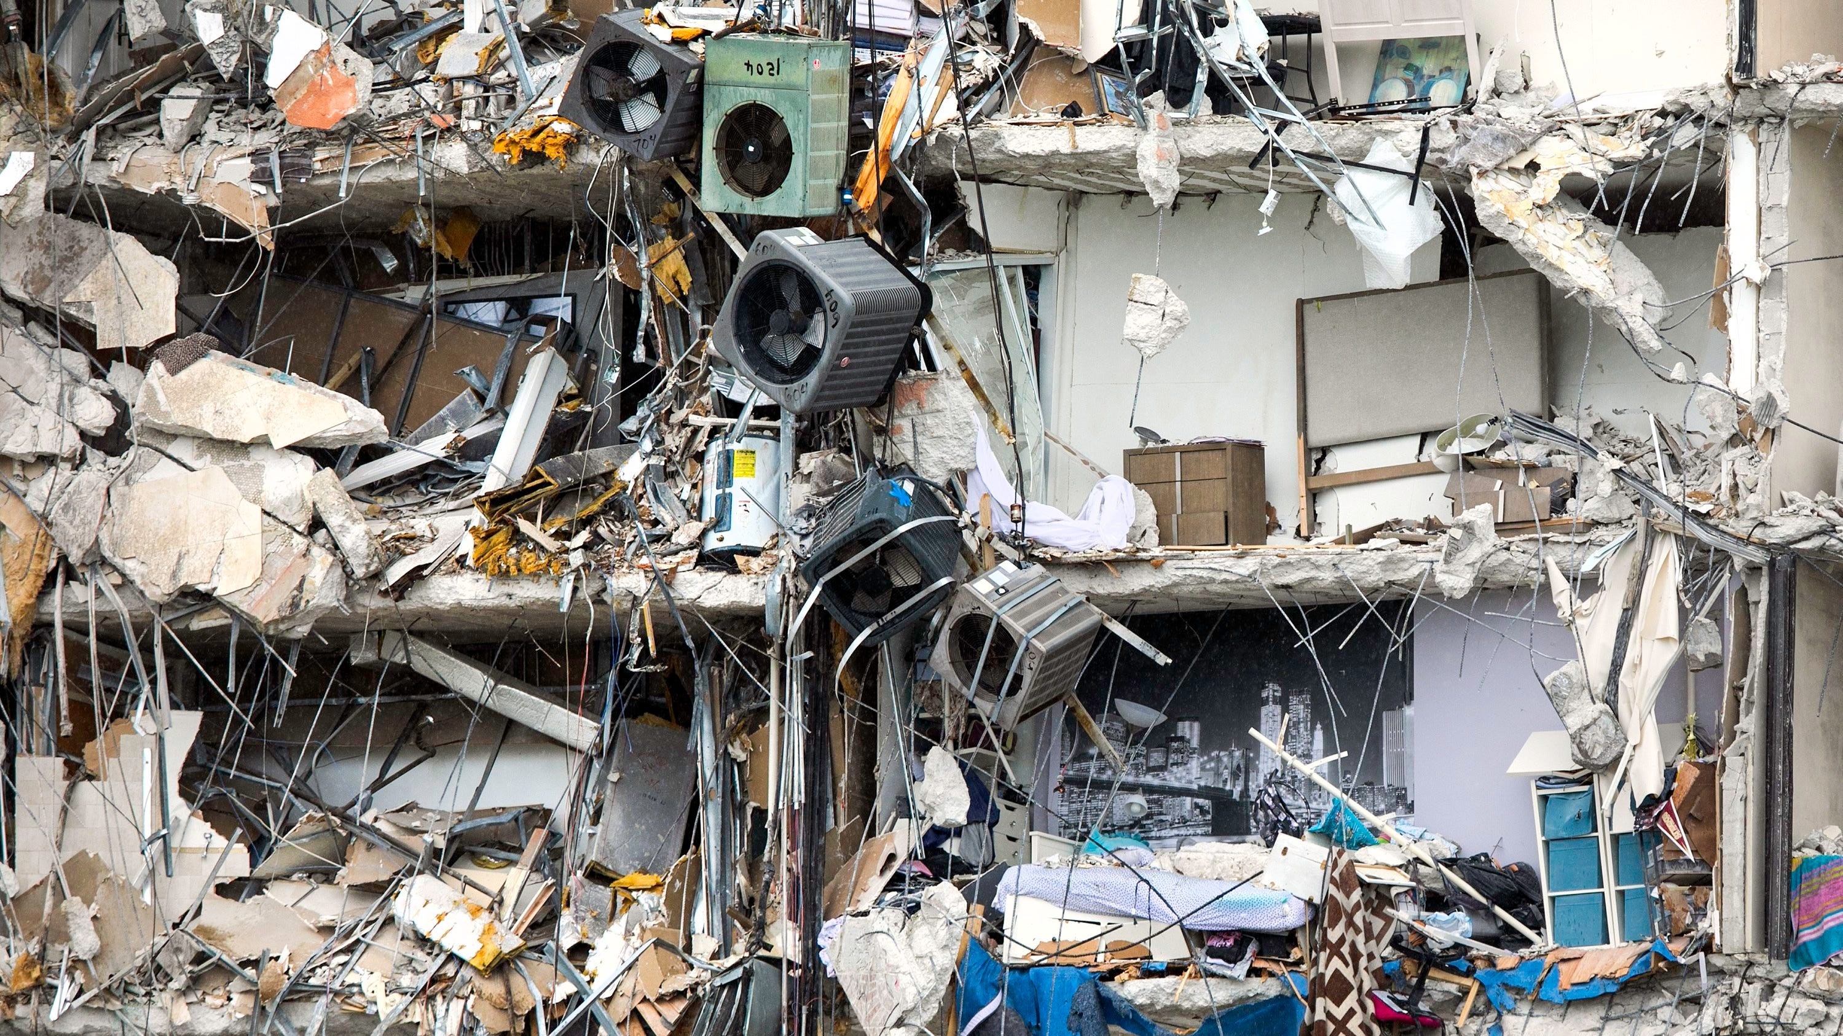
The Lack of Competence Leading to the Failure
Condos were rushed to be built
Briberies were taken by regulators and enforcement
Condo Board and the Chief Building Official who delayed repairs

Slide 9
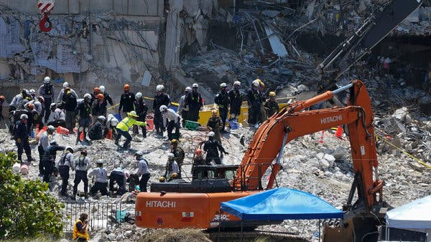
Possible Corrective Actions
Passing bills that require:
Recertifications more frequently
More restrictive building plans
Stricter enforcement on those who don’t follow

Slide 10
Sources
Singhvi, Anjali, et al. The Surfside Condo Was Flawed and Failing. Here’s a Look Inside. Sept 1 ,2021. <https://www.nytimes.com/interactive/2021/09/01/us/miami-building-collapse.html>.
Morabito, Frank P. "MINIMUM INSPECTION PROCEDURAL GUIDELINES FOR BUILDING’S STRUCTURAL RECERTIFICATION." Inspection. 2018. <https://www.townofsurfsidefl.gov/docs/default-source/default-document-library/town-clerk-documents/champlain-towers-south-public-records/8777-collins-ave---unverified-inspection-report.pdf?sfvrsn=8c2a1194_2>.
Morabito Consultants. "Champlain Towers South Condominium Structural Field Survey Report." 2018 <https://www.townofsurfsidefl.gov/docs/default-source/default-document-library/town-clerk-documents/champlain-towers-south-public-records/8777-collins-ave---structural-field-survey-report.pdf>.
Morabito, Frank. "Email Related 2018 Structural Field Survey Report." 2018 <https://www.townofsurfsidefl.gov/docs/default-source/default-document-library/town-clerk-documents/champlain-towers-south-public-records/email-records/email-related-2018-structural-field-survey-report.pdf?sfvrsn=aa311194_2>.
Tejedor, Chrystian. "FIU professor: Collapsed Surfside building showed signs of subsidence in ‘90s." (n.d.). <https://news.fiu.edu/2021/fiu-professor-collapsed-surfside-building-showed-signs-of-subsidence-in-90s-era-space-radar-data>.
Fiaschi, Simone and Shimon Wdowinski. "Local land subsidence in Miami Beach (FL) and Norfolk (VA) and its contribution to flooding hazard in coastal communities along the U.S. Atlantic coast." September 26, 2019 <https://faculty.fiu.edu/~swdowins/publications/Fiaschi-Wdowinski-OCM-2020.pdf>.
Lu, Xinzheng, et al. "A preliminary analysis and discussion of the condominium building collapse in surfside, Florida, US, June 24, 2021." June 24, 2021 <https://link.springer.com/article/10.1007/s11709-021-0766-0>.
Blanchard, Ryan L. "An Investigation and Analysis of the 2021 Surfside Condo Collapse." 2022. <https://scholarworks.uno.edu/cgi/viewcontent.cgi?article=4245&context=td>.
Mazzei, Patricia, et al. "Inside the Tumultuous Years Before the Florida Condo Collapse." July 3, 2021 <https://www.nytimes.com/2021/07/03/us/miami-florida-surfside-collapse.html>.
Gamio, Lazaro, Adam Playford and Michael LaForgia. "Lax Enforcement Let South Florida Towers Skirt Inspections for Years." July 4,2021 <https://www.nytimes.com/2021/07/04/us/south-florida-condo-maintenance-violations.html >.
Glanz, James, Anjali Singhvi and Mike Baker. "Possible Failure Point Emerges in Miami-Area Building Collapse." June 27, 2021 <https://www.nytimes.com/2021/06/27/us/miami-building-investigation-clues.html>.
Allen, Greg. “A Florida condo tower's collapse may have begun on its pool deck.” <https://www.npr.org/2023/06/15/1182502745/surfside-florida-condominium-collapse-investigation>.
Nehamas, Nicholas. “Surfside collapse victims sue Eighty Seven Park condo association and construction firms.” March 8, 2022 <https://www.miamiherald.com/news/special-reports/surfside-investigation/article259163263.html#storylink=cpy>.
Associated Press. “A nearly $1 billion settlement is reached in a Surfside condo collapse lawsuit” May 11, 2022< https://www.npr.org/2022

Slide 11
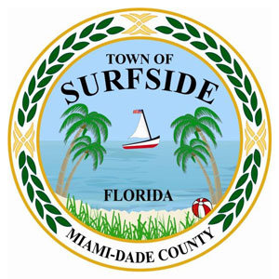
https://commons.wikimedia.org/wiki/Category:IDF_Aid_Mission_to_Surfside_condominium_building_collapse,_2021

Slide 12
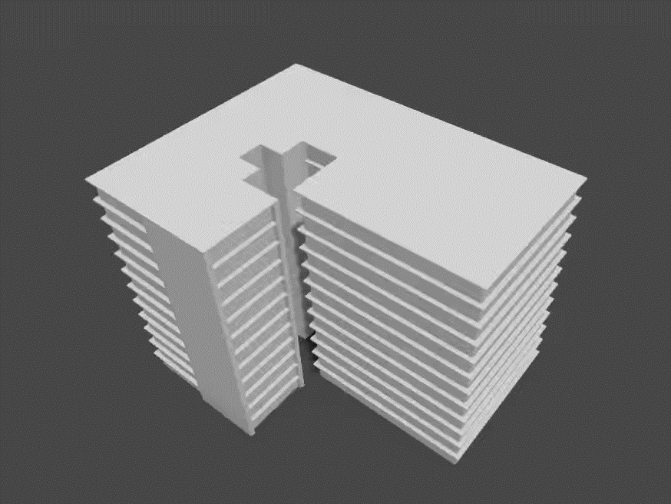

Slide 13
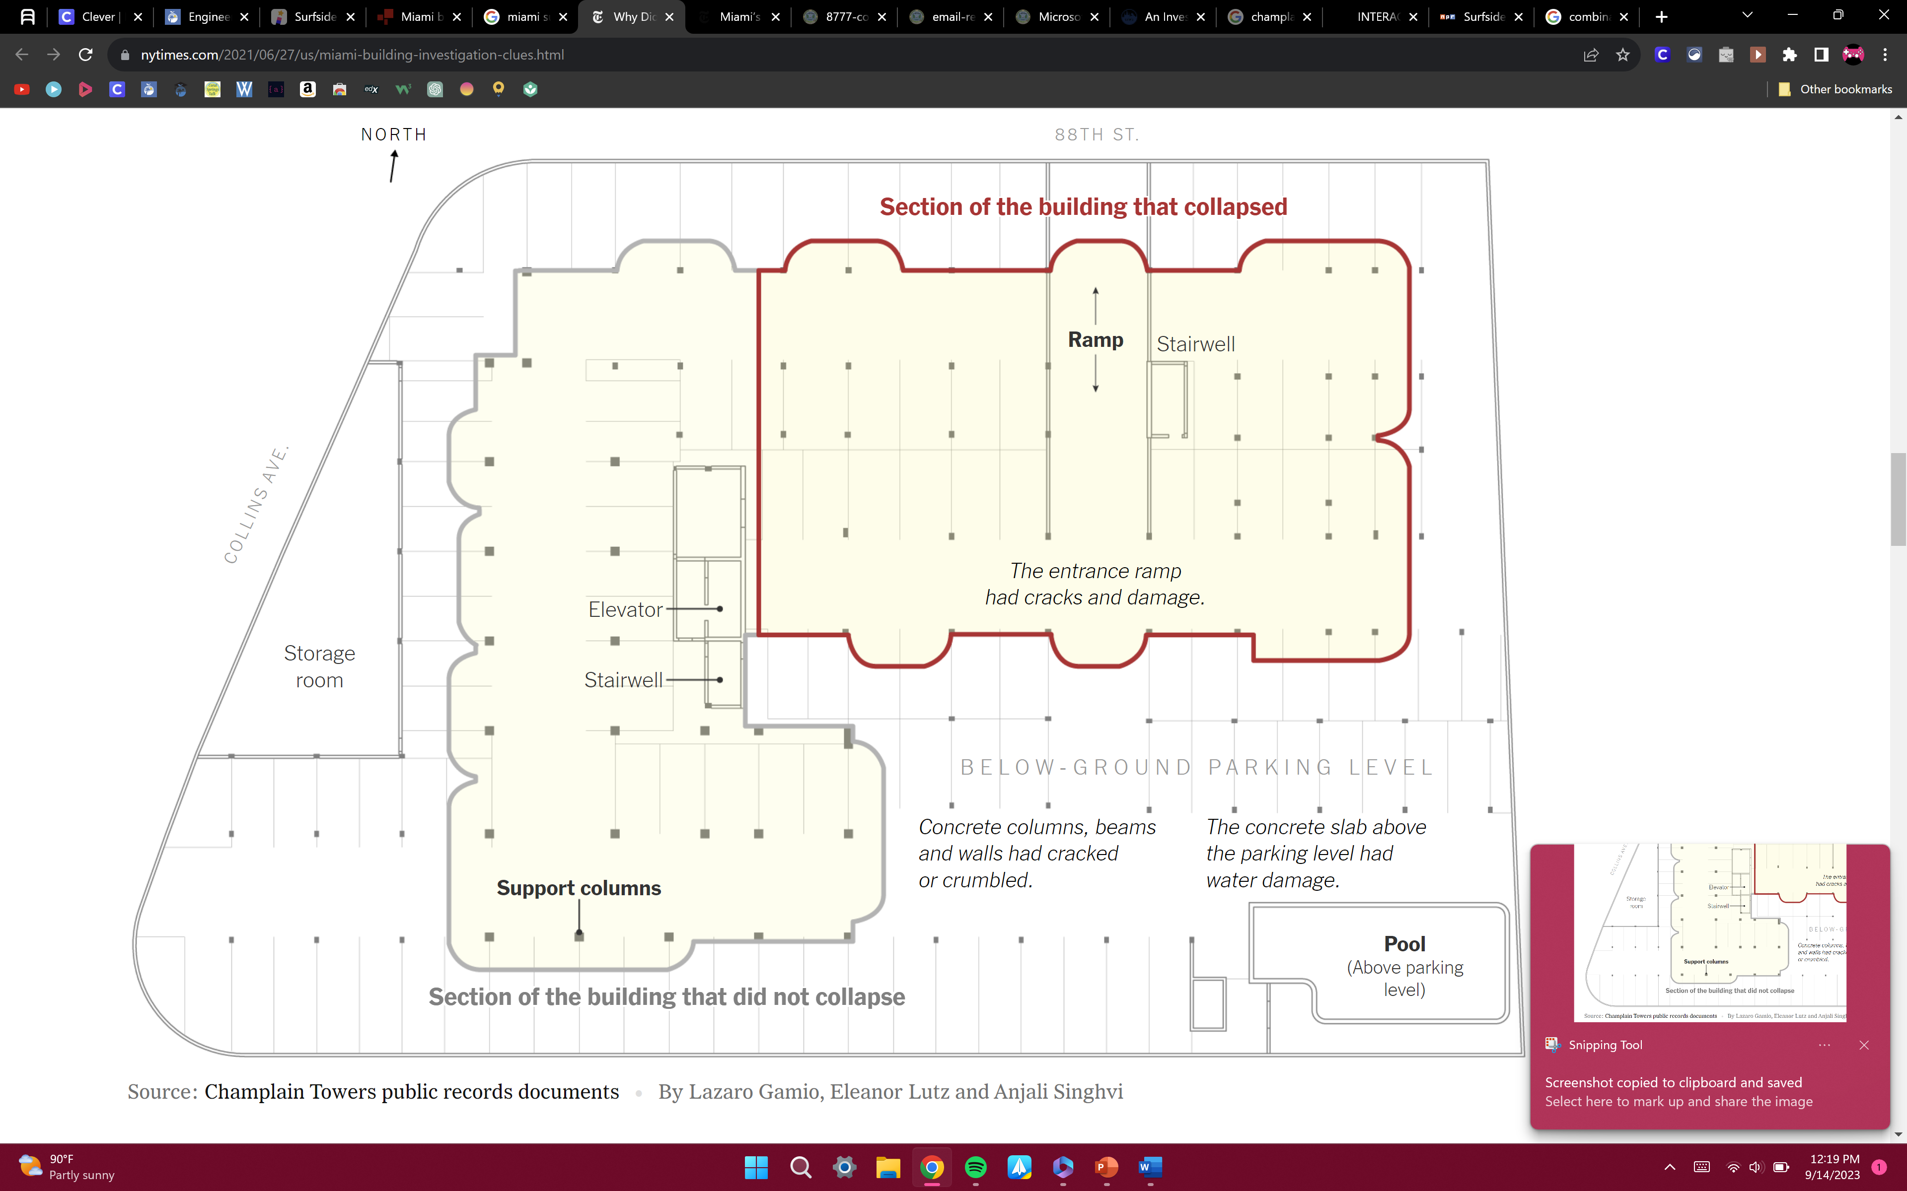

Slide 14
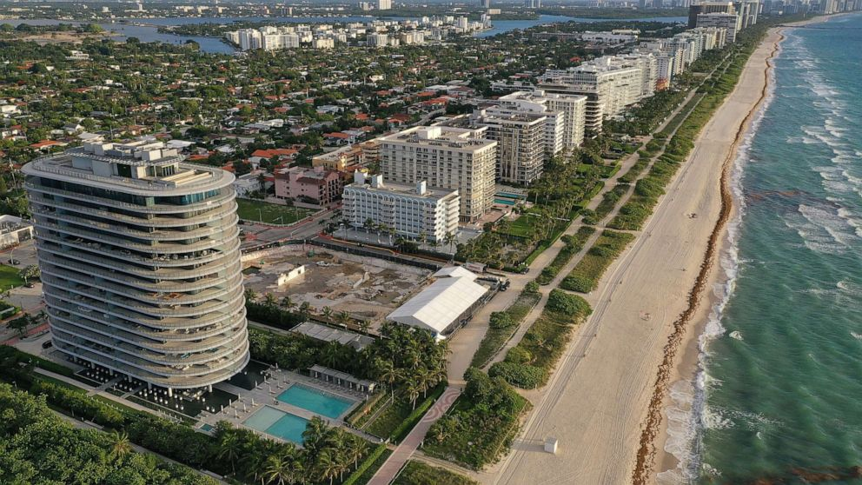

Slide 15
